Slide 1
PRE-ACT TEST INTERPRETATION
Dixon High School

Slide 2
What Is The Pre-ACT?
The Pre-ACT is a paper-based, multiple-choice test in the same four subjects that appear on the ACT: English/Language Arts, Math, Reading, and Science.
The Pre-ACT, gives students practice with the ACT test and empowers them, their parents, and educators with valuable insights as well as the students’ strengths as well as challenges.
The Pre-ACT answers the following questions for students:
“How Am I Doing So FAR?”
“What are my plans and goals after high school?”
“Am I On Track For College?”
The Pre-ACT was administered to all DHS Sophomore students on October 18, 2017.
Notes:
Beginning course details and/or books/materials needed for a class/project.

Slide 3
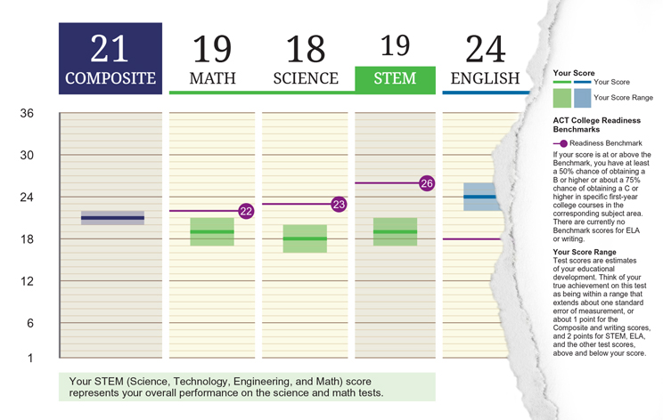
What Do Your Scores Mean?
Your Pre-ACT scores are between 1 and 35.
Pre-ACT takes the number of questions you got right on each test and translates it into a number between 1 and 35 called a “scale score.”
Because no test can measure educational development with absolute precision, it’s best to think of each of your Pre-ACT scores as a range rather than a precise point. Your Pre-ACT score ranges are shown on your Student Report by the colored boxes below your scores.
Your composite score is the average of the English, Math, Reading, and Science test scores (rounded to a whole number).
Your STEM score is the average of the Math and Science test scores.
Notes:
A schedule design for optional periods of time/objectives.

Slide 4
What Do Your Scores Say About Your College Readiness?
Your Pre-ACT college readiness benchmark predicts your future performance in similar college courses for each category.
Pre-ACT scores at or above the benchmark mean that a student has at least a 50% chance of obtaining a B or higher or about a 75% chance of obtaining a C or higher in specific first-year college courses in the corresponding subject areas.
POP QUIZ!
21
WHAT IS THIS STUDENTS’ OVERALL PRE-ACT COMPOSITE SCORE?
THE AVERAGE SCORES OF MATH AND SCIENCE
WHAT DOES THE “STEM” SCORE TELL US?
THE STUDENT IS PREDICTED TO RECEIVE A GRADE BELOW A “B” OR “C”
WHAT IS THIS TEST SAYING ABOUT THE STUDENTS’ PREDICTED COLLEGE PERFORMANCE IN MATH?
Notes:
A schedule design for optional periods of time/objectives.

Slide 5
Your Predicted ACT Score Ranges
Keep in mind that the Pre-ACT and the ACT cover the same subject areas. Your Pre-ACT scores can be used to predict how you are likely to do if you take the ACT as an 11th grader.
Remember that these are only PREDICTIONS!
Notes:
Beginning course details and/or books/materials needed for a class/project.

Slide 6
Your Plans For High School & Beyond
For students who are planning to attend a traditional 4-year college or university, the CORE curriculum that they should be following in high school includes taking:
4 Years of English
3 Years of Math
3 Years of Social Studies/Sciences
3 Years of Science
Onslow County School’s graduation requirements are in alignment with the core curriculum, therefore all DHS students should meet or exceed the core curriculum expectations.
Notes:
Beginning course details and/or books/materials needed for a class/project.

Slide 7
Your Item Response Analysis
The Item Response Analysis gives you a detailed report about what questions that student answered incorrectly, and also those questions that the student did not answer.
The Ideas For Progress section makes suggestions about how the student can improve their score in that particular area on the ACT.
Notes:
Beginning course details and/or books/materials needed for a class/project.

